Slide 1

Problem-Solving

Slide 2

aa
Session Objectives
Define the 5 Whys Method
Apply the 5 Whys Method
Explore Using the 5 Whys Method in Your Zone
1

Slide 3
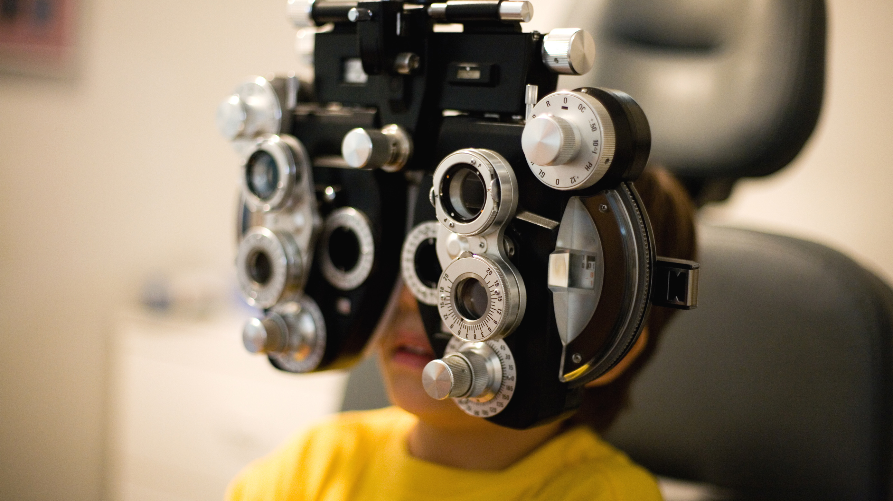

Define the 5 Whys Method
2

Slide 4


aa
What is the 5 Whys Method?
Use to determine root causes
Use for minor or moderately
  complex problems
Use as an individual effort or in teams
Use for problem resolution
3

Slide 5
aa
How to Use the 5 Whys Method
Define the problem
Ask the first “why”
Ask why four more times
Address root causes, make curative actions
4

Slide 6

aa
Problem – Your New Friend is Late
Your new friend is supposed to meet you, but he is late for your meeting. You are curious about why he is late, so you begin to ask him questions.
5

Slide 7
aa
5 Whys to Ask Your Friend
Why were you late?
Why didn’t your alarm clock ring?
Why didn’t your alarm clock have power?
Why didn’t the you change the battery?
Why didn’t you have replacement batteries?
6

Slide 8
aa
Using Curative Actions
Because the alarm clock didn’t ring.
Because it had no power.
Because the battery didn’t work.
Because he had no replacement batteries.
Because he forgot to buy new batteries.
7

Slide 9

aa
Questioning Advice
When you ask Why questions, do it in a friendly, inviting way.
It can feel unsettling to others to be asked many questions in a short period of time.
8

Slide 10

Apply the 5 Whys Method
9

Slide 11

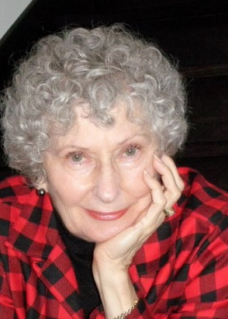

aa
Case Study
A club in your zone lost four new members this year. You decide to contact people from that club to get more information. Read the case study on pages 3 - 4 of your participant manual to see what they said.
Club President
Elena
Lion Marian
New Member
Lion Radha
10

Slide 12

Activity
5 Whys Case Study
Go to pages 3 - 4 of the participant manual and read the case study.
Work with participants at your table to answer the 5 Whys questions on page 5.
Use your answers from the 5 Whys questions on page 5 to answer the curative actions on page 6.
Be ready to share your group’s results
Go to page 3 - 6 in your participant manual.
You have 10 minutes to complete the exercise
11

Slide 13
5 Whys
Answers may vary but should be similar
to the answers below
Why?
Poor new member orientation
Why?
No one takes responsibility for conducting orientation
Why?
New members are told to find orientation materials on the web site
Why?
New members want to learn about our club from other members
Why?
New members feel more connected to our causes by learning from experienced members
12

Slide 14
Possible Curative Actions
First Why - Ensure consistent member orientation
Second Why - Appoint an orientation mentor
Third Why - Ask orientation mentor to train new members
Fourth Why - Assign experienced club members to new members
Fifth Why - Create an inclusive environment for new members
13

Slide 15
aa
Limitations of Using the 5 Whys
Focus on symptoms rather than causes
Formulate results based on investigator’s experience
Identify different root causes from different investigators
Isolate a single cause when there could be many
14

Slide 16

aa
Solving Problems as a Group
Invite those affected by the issue
Select a leader for the meeting
Ask why five times
Assign responsibility for curative actions
Communicate results to the group
15

Slide 17
aa
5 Whys Best Practices
Focus on processes, not people
Investigate without making assumptions
Use groups to problem-solve complex “whys”
Practice 5 Whys techniques to gain proficiency
Confirm root causes to analyze and solve problems
16

Slide 18
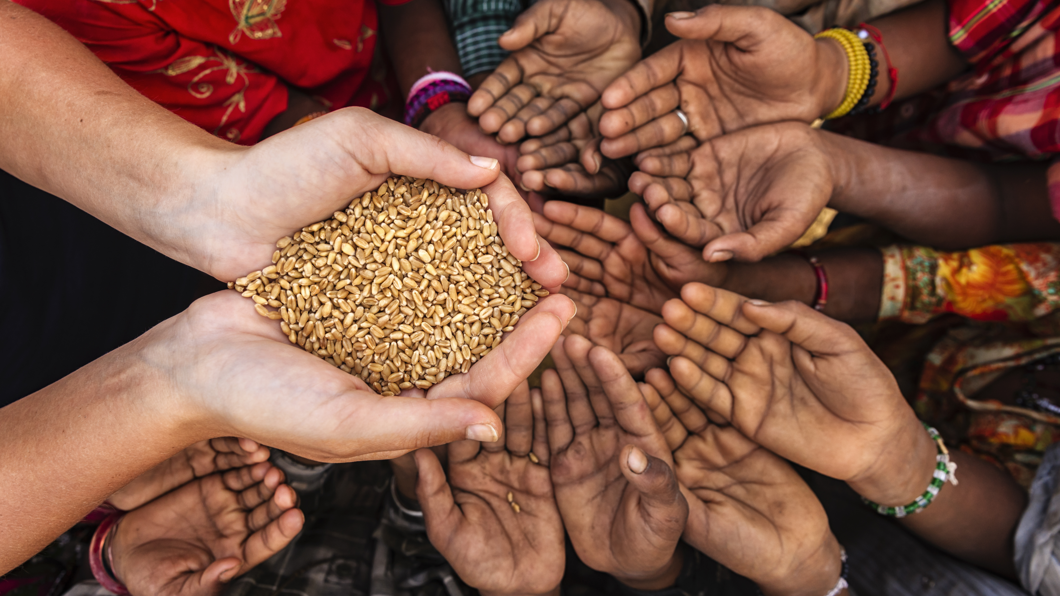
Explore Using the 5 Whys
Method in Your Zone
17

Slide 19
Activity
Using 5 Whys for Zone Problems
Go to pages 7 - 8 of the participant manual to find your 5 Whys Worksheets.
Select two weaknesses from your Zone Chairperson Workshop Pre-assignment SWOT analysis.
Use the 5 Whys Worksheets to work through each problem.
Be ready to share your findings.
Go to pages 7 - 8 in your participant manual.
You have 10 minutes to complete the exercise
18

Slide 20
Maybe you are searching in the branches for what only appears in the roots.
Maulana Jalaluddin Rumi
Poet

Slide 21
aa
Session Objectives
Define the 5 Whys Method
Apply the 5 Whys Method
Explore Using the 5 Whys Method in Your Zone
20

